Slide 1

DEPARTMENT OF ELECTRONICS AND COMMUNICATION ENGINEERING
PHASE 2
PROJECT PRESENTATION ON
IOT BASED AUTOMATIC PET FEEDER
Presented By: Project Guide:
MANOHAR R[1DA20EC076] MANJULA N
MADHU KM [1DA20EC071] Asst.prof. Dept of ECE
KARAN R GOWDA[1DA20EC059] DRAIT
JEEVAN GN[1DA20EC054]

Slide 2
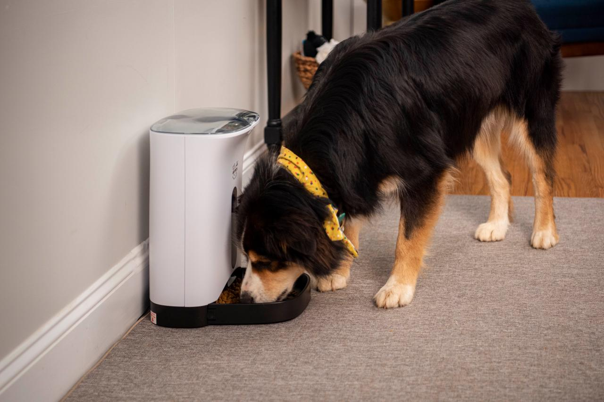
CONTENT:
ABSTRACT
INTRODUCTION
PROBLEM STATEMENT
OBJECTIVES
LITERATURE SURVEY
METHODOLOGY
IMPLEMENTATION
APPLICATIONS AND ADVANTAGES
CONCLUSION
REFERENCES

Slide 3
ABSTRACT:
The motive of our project is to offer a simpler and extra efficient way for the pet owners to feed their pets.
The system makes use of Internet of Things and Digital Image Processing for implementation.
The Ultrasonic Sensor is placed in order to detect the pet in front of the system. Once pet detection is done the camera is switched on and captures image of the pet and processes.
If the pet is recognized as required pet, a dc motor will be activated to dispense food.
This design also contains the call for pet at feed time, refill alert, dual power supply with battery charger, Message alert system for owner in case of pet don’t get it’s feed, safety lock for container, sensor based system to serve previously served feed in case of left feed and the priority feeder with dual option of serve as by owner can opt for multi time and pet can opt for 1 time between feed time gap.

Slide 4
INTRODUCTION:
Nowadays most of us are fascinated to have pets at home.
But in our busy schedule we fail to pay attention on our pet thus it doesn’t get proper food on time.
The above issue is resolved by introducing an Automatic Pet Feeding System to ensure feeding pet on time.
This System consists of food storage, dc motor, dispenser, feeding bowl, ultrasonic sensor and Arduino to control the operations.
Automated pet feeder is one of the new technologies for feeding pet. It will help pet owner to take care of their pet while they are not at home.
Even the owners are not at home, they still can feed their pet. Automated pet feeder is one of the pet feeders that will be controlled by a wireless infra-red remote control.

Slide 5
The automated pet feeder will be automatically dispenses predetermined amounts of food at the exact times user choose with controlled by a wireless infra red remote control.
As pet lovers, user should understand those pets also need a proper diet management. Sometimes, the responsibilities of life inhibit pet owners from properly caring for their pets.
Pet care should be fun, not burdensome and so the goal of this project is to assist owner with pet care by providing an automatic pet feeder.
The purpose of the project helps the owner of the pet feeding their pet on time even when they are not at home.

Slide 6
PROBLEM STATEMENT:
Many pet owners have busy lifestyles or travel frequently, making it difficult to ensure their pets receive timely meals. Traditional feeding methods are limited, and finding a reliable way to feed pets when the owner is not physically present can be a concern.
Sick pets require special diets and large amounts of time and money Difficult to make sure the correct pet is receiving medication or special food No product on the market to address this issue.

Slide 7
OBJECTIVES:
Automate Pet Feeding : Automatically dispense the correct amount of food at scheduled times. Ensures pets are fed even when owners are not home.
Personalize Feeding Plans : Use digital image processing and AI to recognize individual pets. Dispense the appropriate type and amount of food for each pet.
Support Multiple Pet Species : Separate food containers and plates for different species. Store and dispense various types of food suitable for different pets.
Feed Quantity and Time Adjustment :The system allows users to control the quantity of food served in each feeding and the duration the bowl remains accessible for the pet to eat.
Improve Pet Health and Well-being: Prevent overeating or underfeeding.Ensure pets receive the right amount of food at the right times.
Call for pet at feed time This feature is use to call the pet at the time of feed with the owner’s voice which is most familiar to the pet even though the owner is not at home.

Slide 8
LITERATURE SURVEY:
TITLE | YEAR | PUBLISH | AUTHOR | INFERENCE
Design of Smart Pet Food Dispenser using Embedded System | 2023 | IEEE | Ekta Jain,Sakshi Badwaik, Sampada Khirwadkar,Shruti Thakare, Pankaj H.Chandankhede | The project's goal is to create an Internet of Things-based autonomous pet feeding system (IoT). Pets will become obese if we give them free food. This device will also be used to train pets to eat on schedules by keeping track of their feeding patterns.
Pests Detection Using Artificial Neural Network and Image Processing | 2022 | IEEE | Vineet kumar, Vijaya laxmi. | In this paper, Image processing works on the single dimensional image and multidimensional image and checks what happens with the image. Image processing is the core for many developing techniques in real-time aspect.
Design and Implementation of an Automated Feeding System in Poultry Farms | 2021 | IEEE | Ezzaldeem edwan Mohammed abuqassem, Said abual Roos, Mohammed elnaggar | In this paper, designed and implemented an effective, user-friendly automatic feeding system for poultry farms with a view of remedying the current challenges.

Slide 9
TITLE | YEAR | PUBLISH | AUTHOR | INFERENCE
Design and Implementation of A IOT Based Automatic Fish Feeder | 2020 | IEEE | Kajal Jadhav, Gauri Vaidya, Vaishnavi Bankar, Jitendra Gaikwad. | The Arduino Nano microcontroller was used to control the system. It worked according to the design and can be used by fish farmers. Fish farmers can use this to supplement the labour required to grow fishes.
Development of Cat Care System Based on Internet of Things | 2019 | IEEE | Luki B. Subekti Yoanes Bandung Mokhamad Arfan Wicaksono | In this paper, Solutions to the problems aredefined by using internet of things technology. The system is divided into several sub-system that is cat feeder, cat playmate, automatic cat door, cat monitor, and mobile apps. The features for caring the cats can be executed through a mobile phone with internet access or by schedule defined by users.
Pet feeding Dispenser using Arduino and GSM Technology | 2018 | IRJET | Smruthi Kumar | The solenoid valve and servo motor are activated once the message is received. This causes the servo motor to rotate in order to dispense the food. Also, water to be free-flowing, the valve will be open. Once the feeding process is done, the owner will receive a message.

Slide 10
METHODOLOGY
ARDUINO UNO
CAMERA
LCD
PC
DC Motor
H-Bridge
Ultrasonic sensor
Notification
API
Load Cell
Fig 1: Block diagram of automatic pet feeder
The above figure shows the block diagram of automatic pet feeder.

Slide 11
The Arduino IDE is the controller is employed in the model.
The Ultrasonic Sensor is placed in order to detect the pet in front of the system.
The camera which is connected to PC is switched on and captures image of the pet.
If the pet is recognized as required pet, a dc motor will be activated to dispense food. The dc motor is rotated to serve food and the rotation is controlled by H-Bridge.
Sick pets require special diets and large amounts of time and money difficult to make sure the correct pet is receiving medication or special food no product on the market to address this issue.
The diet of pet can be controlled by the DC motor and loadcell which weighs the amount of food in the dispensing bowl.
When the pet is detected using camera, message will be sent to telegram through API.

Slide 12
IMPLEMENTATION:
Start
Initialize the camera, Ultrasonic sensor and Load cell
Waiting for sensor to detect the pet.
No
If
sensor detects the pet
Yes
Pet is Detected, camera turns on.
If detected pet is sick pet
yes
Sick pet
No
Dispense the food
Dispense the food
Load check
Notification
Fig: Flow chart of Automatic pet feeder
Stop

Slide 13
APPLICATIONS AND ADVANTAGES:
Remote Feeding Control: Pet owners can remotely feed their pets using a mobile app, providing convenience and flexibility.
Scheduled Feeding: The system allows for setting up automated feeding schedules, ensuring pets are fed at regular intervals even when the owner is away.
Health Monitoring: Some systems integrate health monitoring, tracking a pet's eating patterns and detecting any irregularities, which can be crucial for early illness detection.
Alerts and Notifications: Receive alerts and notifications about feeding times, low food levels, or any issues with the feeder, enhancing pet care awareness.
Portion Control : this system allows precise portion control ,preventing overfeeding or underfeeding.

Slide 14
Smart Homes: Integrating the pet feeder into a smart home system for centralized control alongside other smart devices.
Pet Boarding Services: Implementing IoT pet feeders in pet boarding services to offer advanced care and monitoring for client pets.
Research and Development: Potential use in research settings to study animal behaviour, dietary patterns, and health-related data.
Pet Training: Incorporate IoT feeders into pet training routines, reinforcing positive behaviours.
Integration with other smart devices : system can integrate with other smart home devices ,allowing for seamless automation and control within home ecosystem.
Data Insights: These devices can collect data on pets eating habits and behavior over time, providing valuable insights to owners and veterinarians for better understanding and managing their pets health.

Slide 15
CONCLUSION :
This design of pet feeder provides the features which will make pet care more convenient for both owner and the pet this system also provides all the information about the pet’s feeding like is it taking feed or not, is it taking feed in proper quantity or not which help in get rid of overfeeding problem. This design also helps in stopping wastage of feed by providing the left feed first. And this design also gives rid of the conventional manual setting of the pet feeders with its interactive remote control. And as go for the advancement some of the features can be modified as using cam at place of sensor for priority feed of pet. And this cam can also provide A small video clip to the owner by multimedia massage of pet at feed time on request.

Slide 16
REFERENCES
In The Year 2022, Kalbande Vaishnavi, Gautami Tikale, Rahul Agrawal, Swati Sorte, Laxman Thakre and Ganesh Khekare, "Design and Implementation of Motion Sensing Security System", 2022 3rd International Conference on Electronics and Sustainable Communication Systems (ICESC).
In the year 2021,Sir Ifeanyi Chinaeke-Ogbuka, Edward Anoliefo, and Augustine Ajibo was worked on Design and Implementation of an Automated Feeding System for Poultry Farms.
In the year 2020, Madukwe Chinaza A, was worked on Design and Implementation of A GSM Based Automatic Fish Feeder.
In The Year 2020, Pravin R. Kshirsagar, Hariprasath Manoharan, Fadi AI-Turjman and Kailash Kumar Maheshwari, "Design and testing of automated smoke monitoring sensors in vehicles", IEEE Sensors Journal.
In the year 2019, Sir Hari N. Khatavkar, Rahul S. Kini, Suyash K. Pandey, Vaibhav V. Gijare, was worked on Intelligent Food Dispenser (IFD).
In the Year 2019 Hari N. Khatavkar, Rahul S. Kini, Suyash K. Pandey and Vaibhav V. Gijare, "Intelligent Food Dispenser (IFD)", published by IOSR Journal of Engineering (IOSRJEN)
In the year 2018, Sir R. Ravikumar, Dr. V. Arulmozhi, was worked on Digital Image Processing-A Quick Review.

Slide 17
THANK YOU ☺

